Slide 1
Final Year Project
Identification of Essential Protein based on Protein-Protein Interaction Network (PPIN)
Submitted by:-
Alokananda Ghosh (25500115004)
Anannya Bhattacharjee (25500115005)
Ananya Chakraborty (25500115006)
Dyuti Giri (25500115017)
Under Guidance of Prof. SOVAN SAHA

Slide 2
AGENDA
Overview
Local properties of nodes in a PPIN
Protein-Protein Interaction Network (PPIN)
New Centrality Measure : LBCC
Importance of PPIN
Explanation
Paper Study
Evaluation Methods
Overlay Structure
Result
Dataset Use
Conclusion
Methodology
References

Slide 3
Overview
The main aim of this project is based on working on the Identification of Essential Proteins based on Network Topological Properties and Protein Complexes.
Proteins are large biomolecules, or macromolecules, consisting of one or more long chains of amino acid residues. Proteins perform a vast array of functions within organisms, including catalysing metabolic reactions, DNA replication, responding to stimuli, providing structure to cells and organisms, and transporting molecules from one location to another.

Slide 4
Protein-Protein Interaction Network (PPIN)
Protein-protein interactions (PPIs) are essential to almost every process in a cell. Protein-protein interaction networks (PPIN) are mathematical representations of the physical contacts between proteins in the cell.
01
These contacts are specific.
02
They occur between defined binding regions in the proteins.
03
They have a particular biological meaning (i.e., they serve a specific function).

Slide 5
IMPORTANCE OF PPI NETWORK
Essential proteins are indispensable to the viability and reproduction of an organism. Knowledge of PPIs can be used to:
01
Assign putative roles to uncharacterised proteins.
02
Add fine-grained detail about the steps within a signalling pathway.
Characterise the relationships between proteins that form multi-molecular complexes such as the proteasome.
03

Slide 6
PAPER STUDY
OVERLAY STRUCTURE
A New Method for Identifying Essential Proteins Based on Network Topology Properties and Protein Complexes.
There are two types of methods for predicting essential proteins. One is experimental procedures, such as RNA interference, single gene knockouts, and conditional knockouts. However, these procedures time and resource consuming are not practical.
The other type of method is bioinformatics computational approaches that take advantage of the abundance of experimental data available for protein interaction networks, such as (DC), (BC), (SC), (EC), (NC), and (LAC). Obviously, the latter is faster and less expensive than the former.

Slide 7
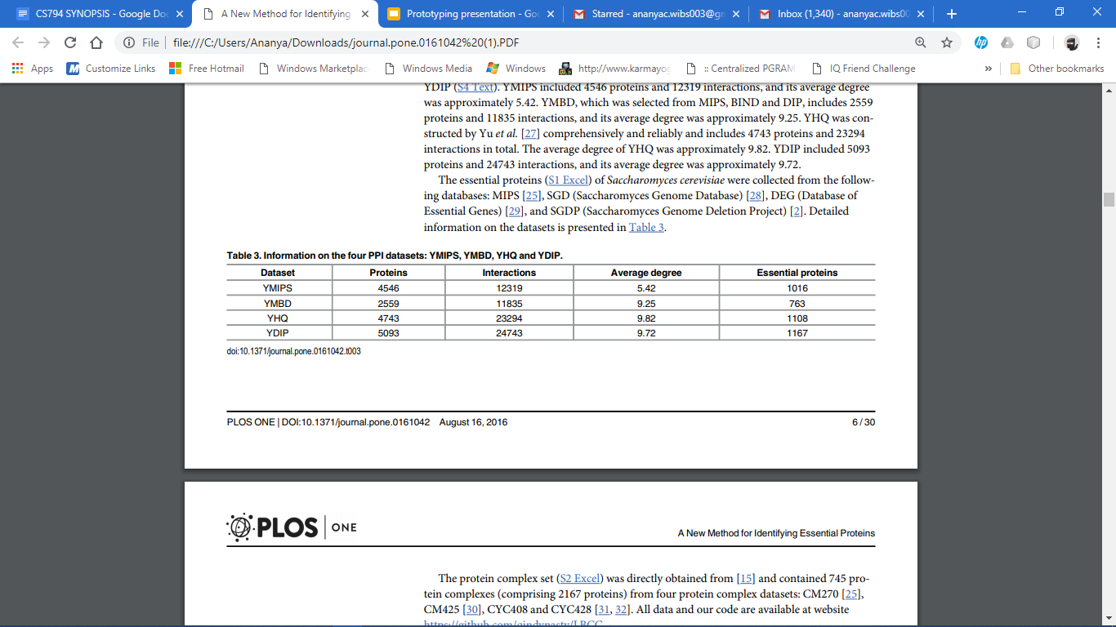
DATASET USE

Slide 8
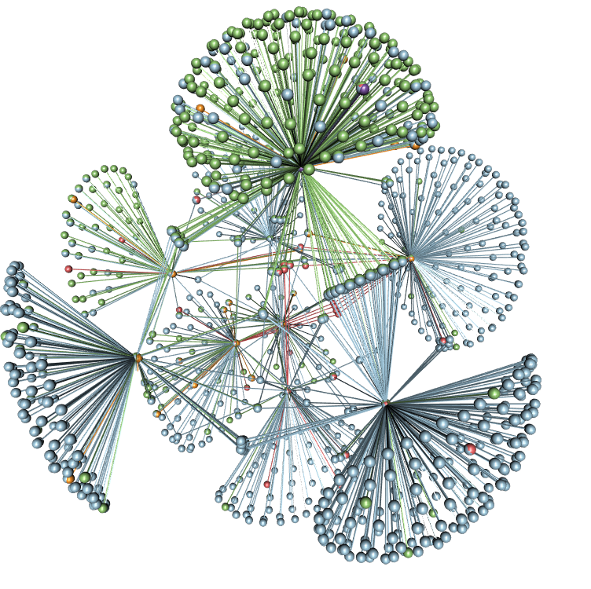
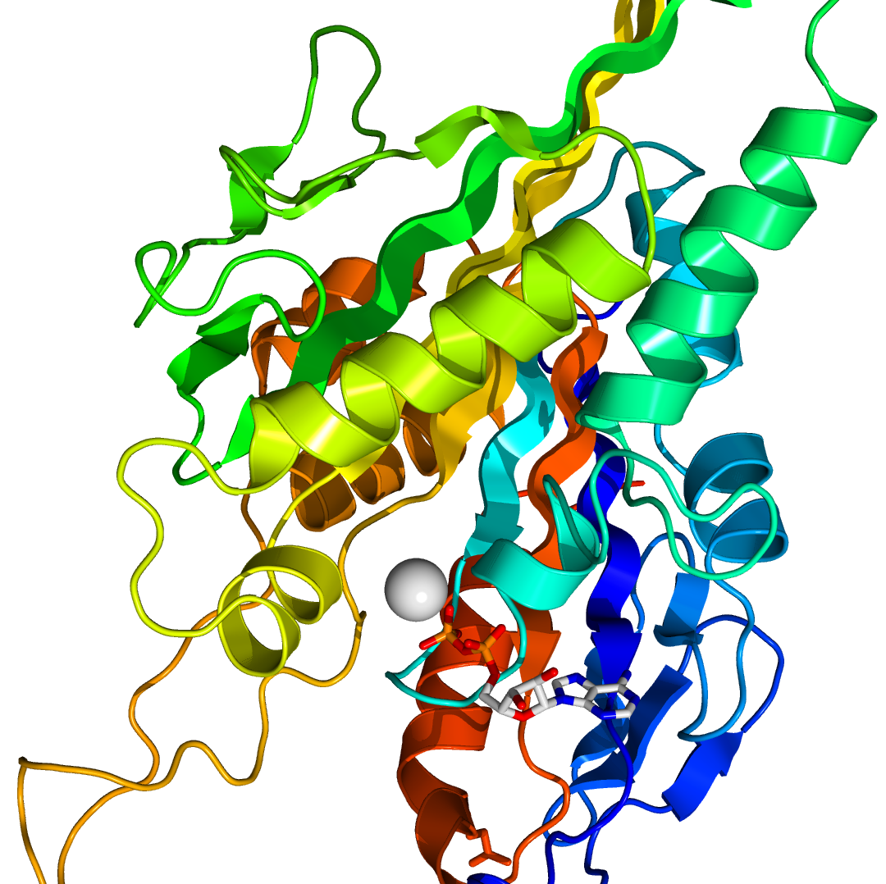
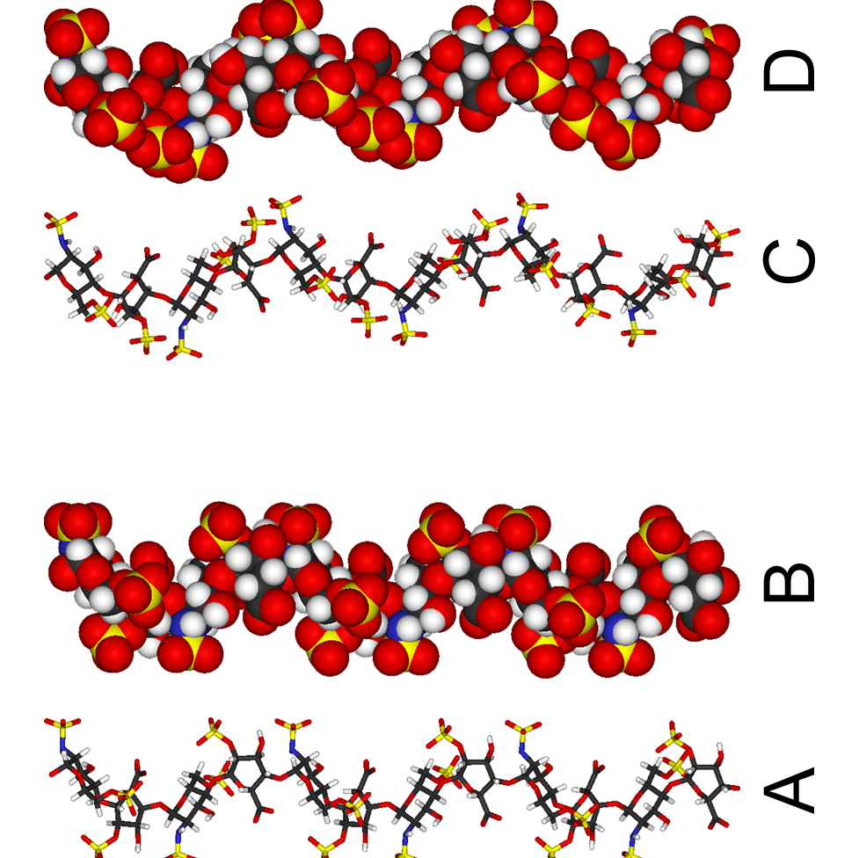
Methodology
Centrality Measures
Here, six classical centrality measures based on network topological properties are introduced.
Degree Centrality (DC)
Betweenness Centrality (BC)
Subgraph Centrality (SC)
Eigenvector Centrality (EC)
Local Average Connectivity Centrality (LAC)
In-Degree Centrality of Complex (IDC)

Slide 9
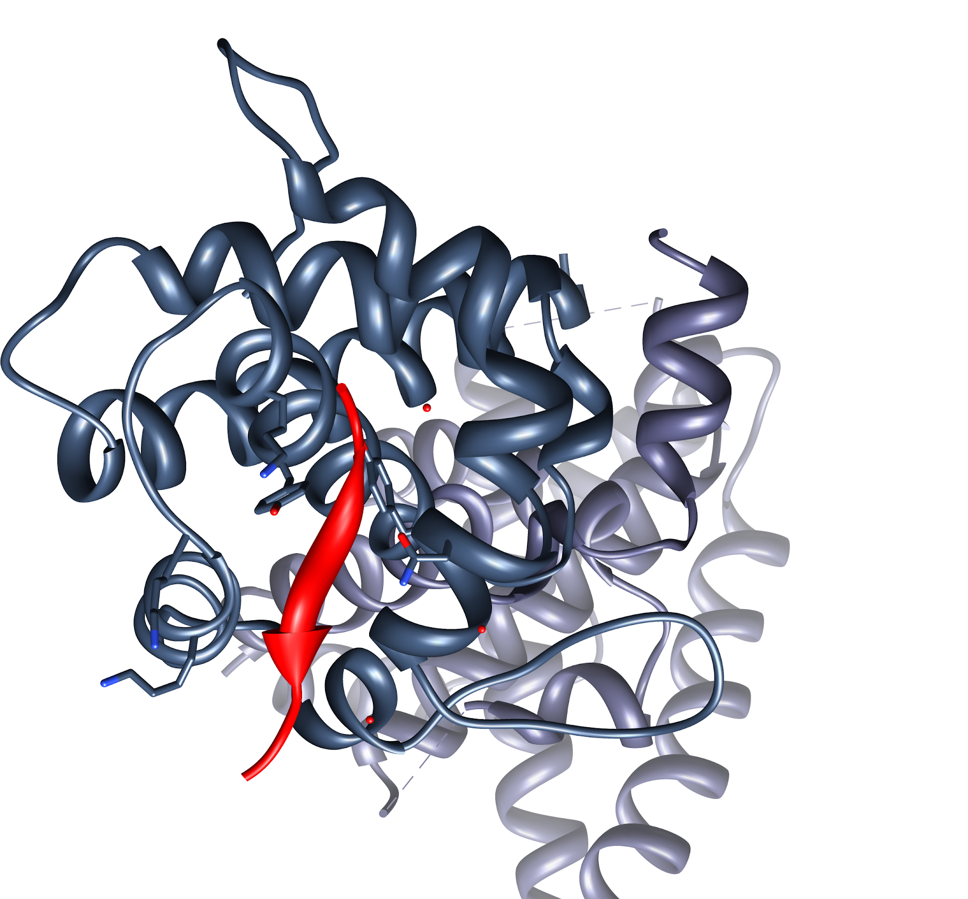
Local properties of nodes in a PPI network
In this section, two types of local properties of nodes in a PPI network are introduced, Den1(v) and Den2(v), which are defined as follows.
Den1(v) is the proportion of the number of the edges to the number of all possible edges of H. Den1(v) is somewhat different from LCC(v).
Den2(v) is the density of the subgraph induced by v and the set of nodes for which the distance to v is 1 or 2.
The local properties Den1(v) and Den2(v) are important for aiding in locating essential proteins.

Slide 10
New centrality measure: LBCC
In this section, we propose a new method, LBCC, by combining Den1, Den2, BC and IDC. The following basic concepts underlie LBCC:
Essential proteins tend to form highly connected clusters.
Essential proteins gather in protein complexes .
Both local and global properties are important for aiding in locating essential proteins.

Slide 11
Explanation
Methods based on bioinformatics computational approaches are sensitive to the local or global topological properties of the network, and the prediction precision for identifying essential proteins requires further improvement.
In this paper, we first introduce the densities Den1(v) and Den2(v) of a node v to describe its local properties in the network. Then, a novel method called LBCC is proposed, which is combined with Den1, Den2, BC, and IDC, where the local and global properties of the node are measured by Den1 and Den2 and by BC, respectively, and the information of the protein complex is measured by IDC.
In particular, compared to the most recent method, LIDC, which is a more effective method for predicting essential proteins, LBCC improves the prediction precision by at least 10 percent on the YMIPS and YMBD datasets.

Slide 12
Evaluation Methods (4 statistical terms)
04
True Positives(TP)
False Negatives(FN)
The essential proteins that are correctly selected as essential.
The essential proteins that are incorrectly selected as non- essential.
01
03
True Negatives(TN)
False Positives(FP)
The non-essential proteins that are incorrectly selected as essential.
The non-essential proteins that are correctly selected as non-essential.
02

Slide 13
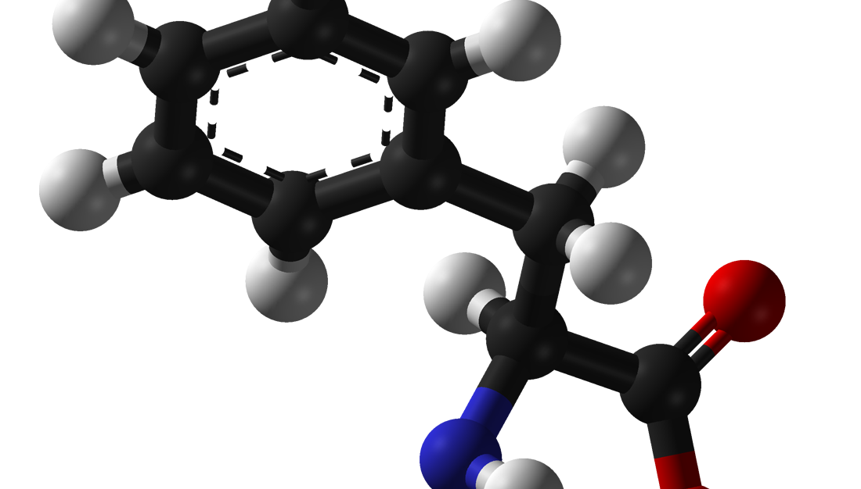
Evaluation Methods
(Six Statistical Measures)
Sensitivity (SN)
Specificity (SP)
Positive Predictive Value (PPV)
Negative Predictive Value (NPV)
F-measure (F)
Accuracy (ACC)

Slide 14
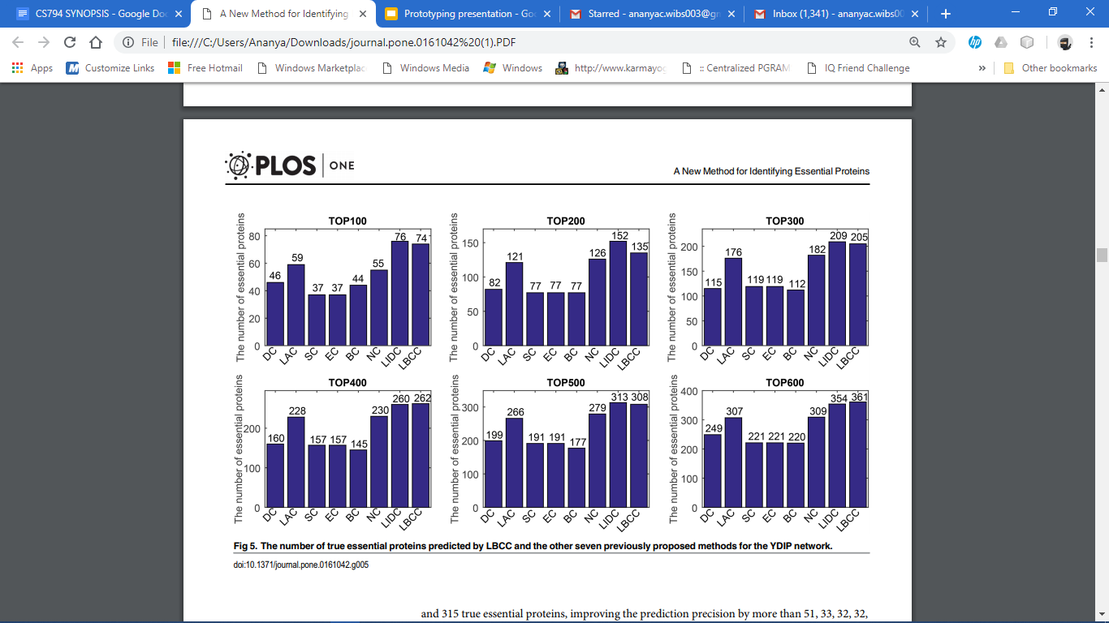
Result (for YDIP network)

Slide 15
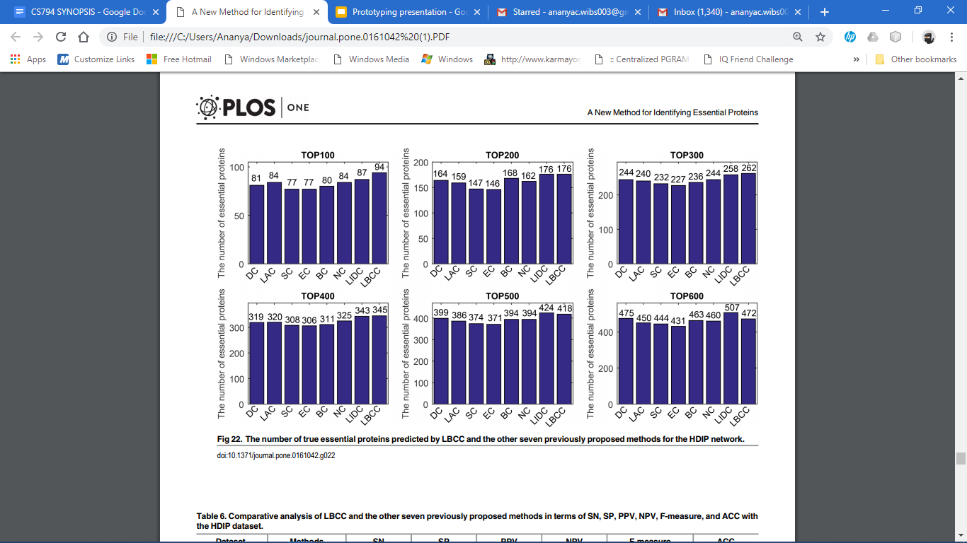
Result (for HDIP network)

Slide 16
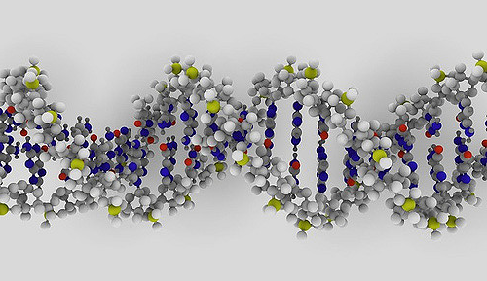
Conclusion
The identification of essential proteins is helpful for comprehending the minimal requirements for cellular life, and many approaches based on topological properties have been proposed for discovering essential proteins in PPI networks. In future studies, we will integrate additional information, such as domain information, gene ontology and gene expression data, to predict essential proteins more effectively and accurately.

Slide 17



References
Qin C, Sun Y, Dong Y (2016) A New Method for Identifying Essential Proteins Based on Network Topology Properties and Protein Complexes. PLoS ONE 11(8): e0161042. doi:10.1371/journal. Pone.0161042
https://www.ebi.ac.uk/training/online/course/network-analysis-protein-interaction-data-introduction/protein-protein-interaction-networks
https://en.wikipedia.org/wiki/Protein%E2%80%93protein_interaction
https://www.nature.com/subjects/protein-protein-interaction-networks
Luo J, Qi Y (2015) Identification of Essential Proteins Based on a New Combination of Local Interaction Density and Protein Complexes. PLoS ONE 10(6): e0131418. doi:10.1371/journal. pone.0131418

Slide 18
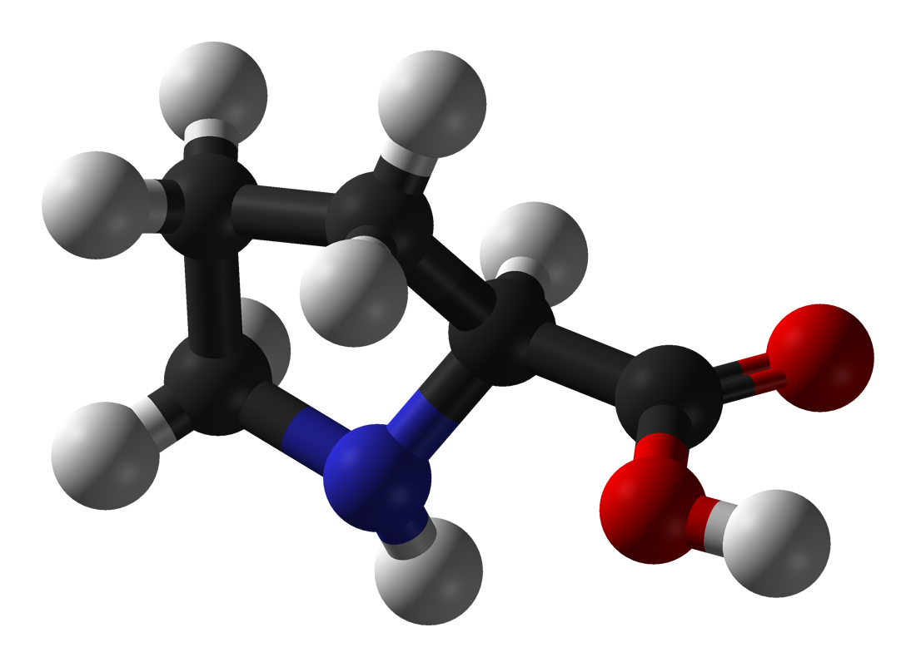
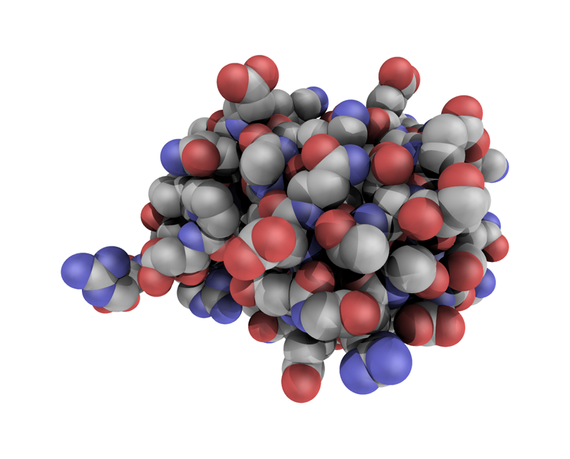
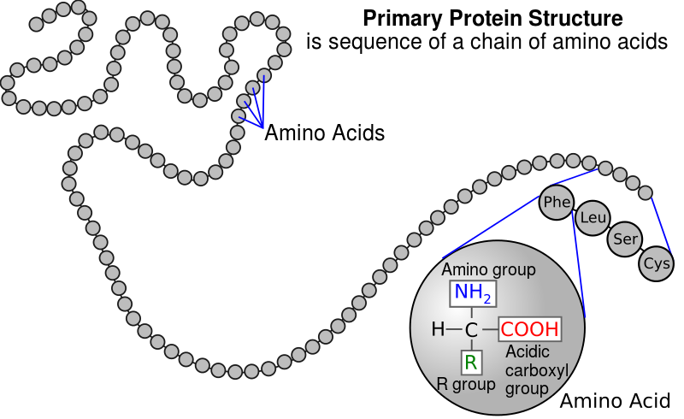

Thank you!

